Slide 1
Pleasant Park
By: Austin, Cole, and Jesse

Slide 2
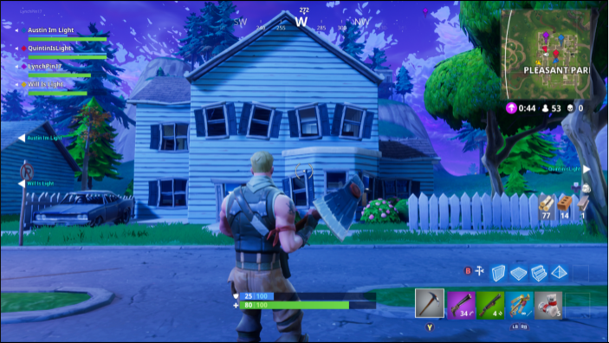
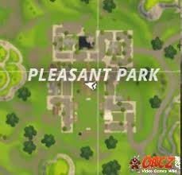
Pleasant Park

Slide 3
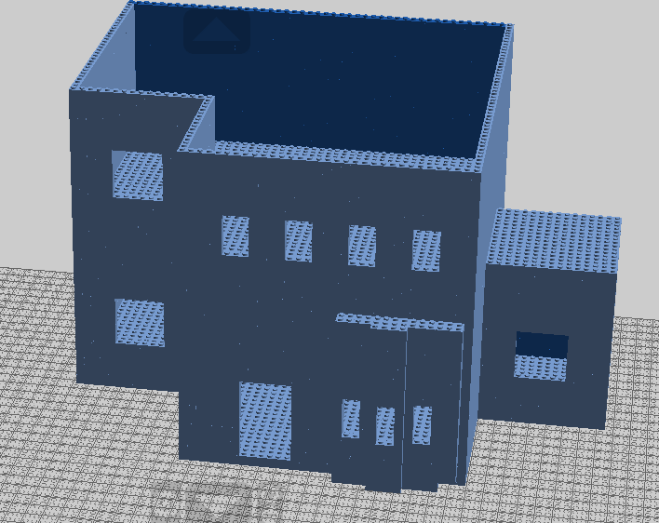
The First House

Slide 4
Roles
Current Roles: Work all together on a single house.
Future Roles: Move forward with our own assigned codes to do.
Cole: Special houses; Modern, Treehouse etc
Austin: Park and Fields
Jesse: Normal Houses

Slide 5
Biggest Obstacles
Consistency
Starting off
Coordination

Slide 6
Plans for Spring Break
Record and take more pictures of the town.
Figure out who’s doing what and how.

Slide 7
After Spring Break
Do our individual assignments
Try and stay on track with our weekly plans

